Slide 1
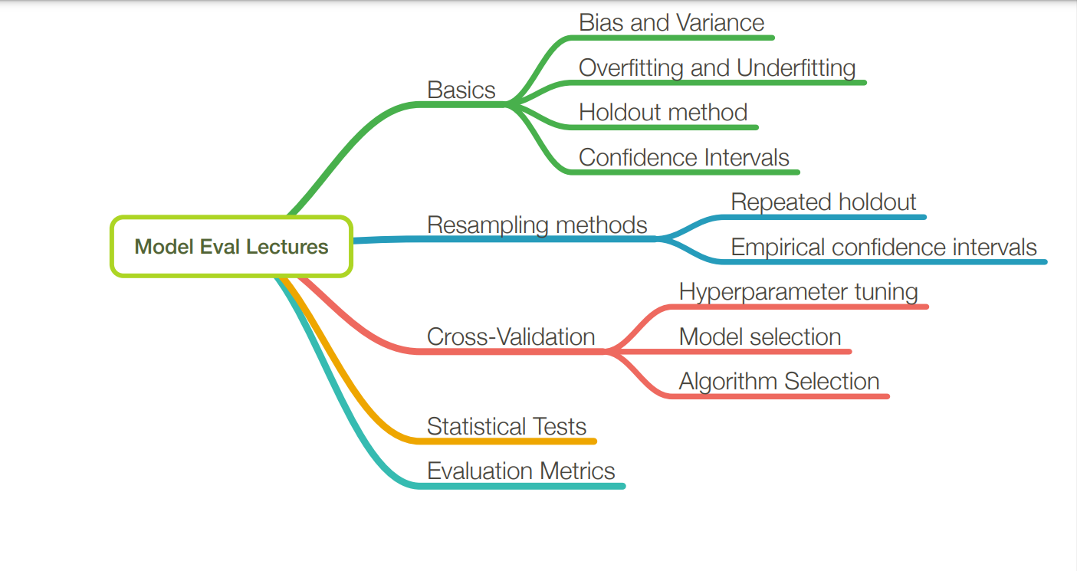
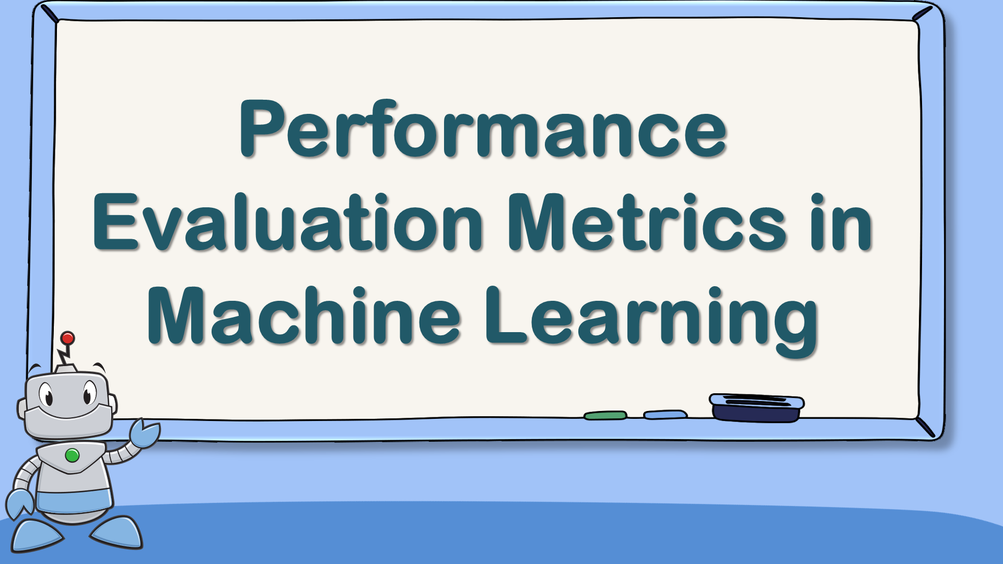
Learning outcome 3: Model Evaluation Techniques

Slide 2
Introduction to performance evaluation metrics
In Machine Learning, the performance evaluation metrics are used to calculate the performance of your trained machine learning models.
This helps in finding how better your machine learning model can perform on a dataset that it has never seen before.
To evaluate the performance or quality of the model, different metrics are used, and these metrics are known as performance metrics or evaluation metrics.

Slide 3
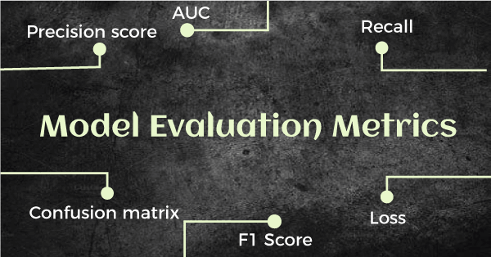
These performance metrics help us understand how well our model has performed for the given data.
In this way, we can improve the model's performance by tuning the hyper-parameters.
Each ML model aims to generalize well on unseen/new data, and performance metrics help determine how well the model generalizes on the new dataset.

Slide 4
Types of performance metrics
In machine learning we have three main types of performance metrics:
Classification Metrics
2. Regression Metrics
3. Clustering Metrics

Slide 5
1. Classification Metrics
Classification metrics assess the performance of machine learning models for classification tasks. They aim to assign an input data point to one of several predefined categories
These metrics are used to assess model accuracy, precision, recall, and other aspects
Classification metrics can be grouped into three main categories: Accuracy, sensitivity, specificity.

Slide 6
I. Confusion Matrix
A confusion matrix, also known as an error matrix, is a tool used to evaluate the performance of classification models in machine learning and statistics.
It presents a summary of the predictions made by a classifier compared to the actual class labels, allowing for a detailed analysis of the classifier's performance across different classes.

Slide 7
Need for Confusion Matrix in Machine learning
It evaluates the performance of the classification models, when they make predictions on test data, and tells how good our classification model is.
It not only tells the error made by the classifiers but also the type of errors such as it is either type-I or type-II error.
With the help of the confusion matrix, we can calculate the different parameters for the model, such as accuracy, precision, etc.

Slide 8
The confusion matrix provides a comprehensive view of the model's performance, including each class's correct and incorrect predictions.
It helps identify misclassification patterns and calculate various evaluation metrics such as precision, recall, F1-score and accuracy.
By analyzing the confusion matrix, you can diagnose the model's strengths and weaknesses and improve its performance.

Slide 9
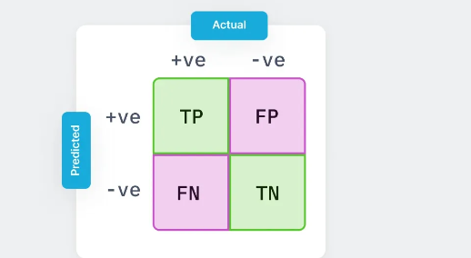
.
the table is divided into four terminologies, which are as follows:
True Positive(TP): In this case, the prediction outcome is true, and it is true in reality, also.
True Negative(TN): in this case, the prediction outcome is false, and it is false in reality, also.
False Positive(FP): In this case, prediction outcomes are true, but they are false in actuality.
False Negative(FN): In this case, predictions are false, and they are true in actuality.

Slide 10
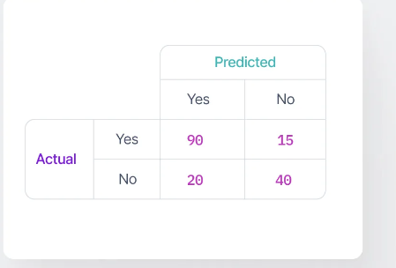
Let's create a confusion matrix in the given disease classification case and interpret it.
Here's the confusion matrix:
From this confusion matrix, we can interpret the following:
TP (90): Out of 105 patients with the disease, the model correctly predicted "yes" for 90 patients.
FN (15): The model incorrectly predicted "no" for 15 patients with the disease.
FP (20): Out of 60 patients without the disease, the model incorrectly predicted "yes" for 20 patients.
TN (40): The model correctly predicted "no" for 40 patients who don't have the disease.

Slide 11
Calculations using Confusion Matrix:
We can perform various calculations for the model, such as the model's accuracy, using this matrix. These calculations are given below:
1. Classification Accuracy: It is one of the important parameters to determine the accuracy of the classification problems. It defines how often the model predicts the correct output.
It can be calculated as the ratio of the number of correct predictions made by the classifier to all number of predictions made by the classifiers. The formula is given below:

Slide 12
2. Misclassification rate: It is also termed as Error rate, and it defines how often the model gives the wrong predictions. The value of error rate can be calculated as the number of incorrect predictions to all number of the predictions made by the classifier.
The formula is given below
Precision: It can be defined as the number of correct outputs provided by the model or out of all positive classes that have predicted correctly by the model, how many of them were actually true. It can be calculated using the below formula:

Slide 13
3. Recall: It is defined as the out of total positive classes, how our model predicted correctly. The recall must be as high as possible.
4. F-measure: If two models have low precision and high recall or vice versa, it is difficult to compare these models. So, for this purpose, we can use F-score. This score helps us to evaluate the recall and precision at the same time.
The F-score is maximum if the recall is equal to the precision.

Slide 14
5. AUC-ROC
Sometimes we need to visualize the performance of the classification model on charts; then, we can use the AUC-ROC curve. It is one of the popular and important metrics for evaluating the performance of the classification model.
Firstly, let's understand ROC (Receiver Operating Characteristic curve) curve. ROC represents a graph to show the performance of a classification model at different threshold levels. hence can be calculated as:

Slide 15


The curve is plotted between two parameters, which are:
True Positive Rate
False Positive Rate
TPR or true Positive rate is a synonym for Recall,
FPR or False Positive Rate can be calculated as:

Slide 16
2. Performance Metrics for Regression
Regression is a supervised learning technique that aims to find the relationships between the dependent and independent variables.
A predictive regression model predicts a numeric or discrete value.
The metrics used for regression are different from the classification metrics.
It means we cannot use the Accuracy metric (explained above) to evaluate a regression model; instead, the performance of a Regression model is reported as errors in the prediction

Slide 17
Following are the popular metrics that are used to evaluate the performance of Regression models.
Mean Absolute Error
Mean Squared Error
R2 Score
Adjusted R2

Slide 18

I. Mean Absolute Error (MAE)
Mean Absolute Error or MAE is one of the simplest metrics, which measures the absolute difference between actual and predicted values, where absolute means taking a number as Positive.
To understand MAE, let's take an example of Linear Regression, where the model draws a best fit line between dependent and independent variables.
To measure the MAE or error in prediction, we need to calculate the difference between actual values and predicted values.
The below formula is used to calculate MAE:

Slide 19
II. Mean Squared Error
Mean Squared error or MSE is one of the most suitable metrics for Regression evaluation.
It measures the average of the Squared difference between predicted values and the actual value given by the model.
Since in MSE, errors are squared, therefore it only assumes non-negative values, and it is usually positive and non-zero.
Moreover, due to squared differences, it penalizes small errors also, and hence it leads to over-estimation of how bad the model is.

Slide 20
III. R Squared Score
R squared error is also known as Coefficient of Determination, which is another popular metric used for Regression model evaluation.
The R-squared metric enables us to compare our model with a constant baseline to determine the performance of the model.
To select the constant baseline, we need to take the mean of the data and draw the line at the mean.

Slide 21

The R squared score will always be less than or equal to 1 without concerning if the values are too large or small.

Slide 22

IV. Adjusted R Squared
Adjusted R squared, as the name suggests, is the improved version of R squared error.
R square has a limitation of improvement of a score on increasing the terms, even though the model is not improving, and it may mislead the data scientists.
To overcome the issue of R square, adjusted R squared is used, which will always show a lower value than R².
It is because it adjusts the values of increasing predictors and only shows improvement if there is a real improvement.

Slide 23

Methods for model evaluation
This technique of Evaluation helps us to know which algorithm best suits the given dataset for solving a particular problem.
There are two methods that are used to evaluate a model performance.
Hold-out validation
Cross validation (k-fold cross validation)

Slide 24
Hold-out validation
The Hold out method is used to evaluate the model performance and uses two types of data for testing and training.
Also called a train-test split, holdout cross-validation has the entire dataset partitioned randomly into a training set and a validation set.
A rule of thumb to partition data is that nearly 70% of the whole dataset will be used as a training set and the remaining 30% will be used as a validation set.

Slide 25
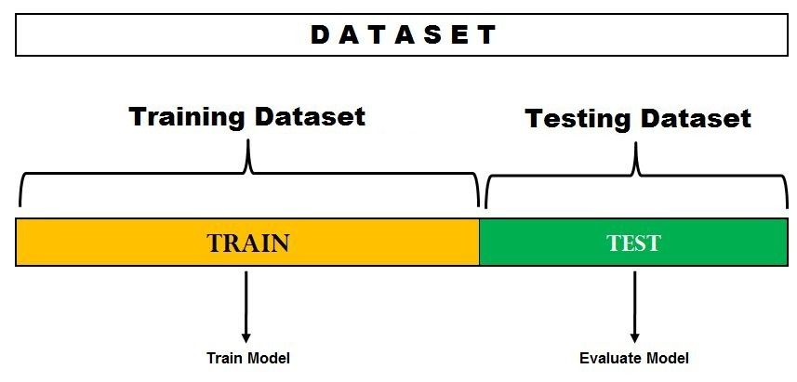
In the image above, the dataset is split into a training set and a test set.
You can train the model on the training set and test it on the testing dataset.

Slide 26
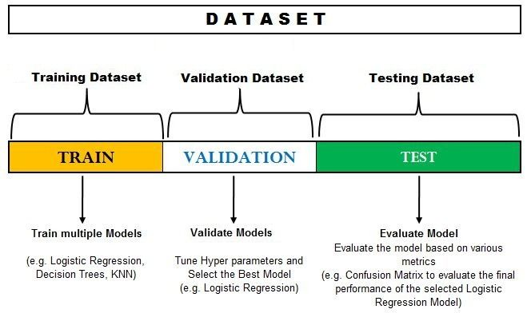

Slide 27
2. Cross validation (k-fold cross validation)
Cross-validation is a procedure of dividing the whole dataset into data samples, and then evaluating the machine learning model using the other samples of data to know accuracy of the model. i.e., we train the model using a subset of data and we evaluate it with a complementary data subset.
We can calculate cross validation based on the following 3 methods:
1.Validation
2.Leave one out cross validation (LOOCV)
3. K-Fold Cross Validation

Slide 28
1. Validation : We divide our input dataset into a training set and test or validation set in the validation set approach. Both the subsets are given 50% of the dataset.
But it has one of the big disadvantages that we are just using a 50% dataset to train our model, so the model may miss out to capture important information of the dataset. It also tends to give the underfitted mode

Slide 29
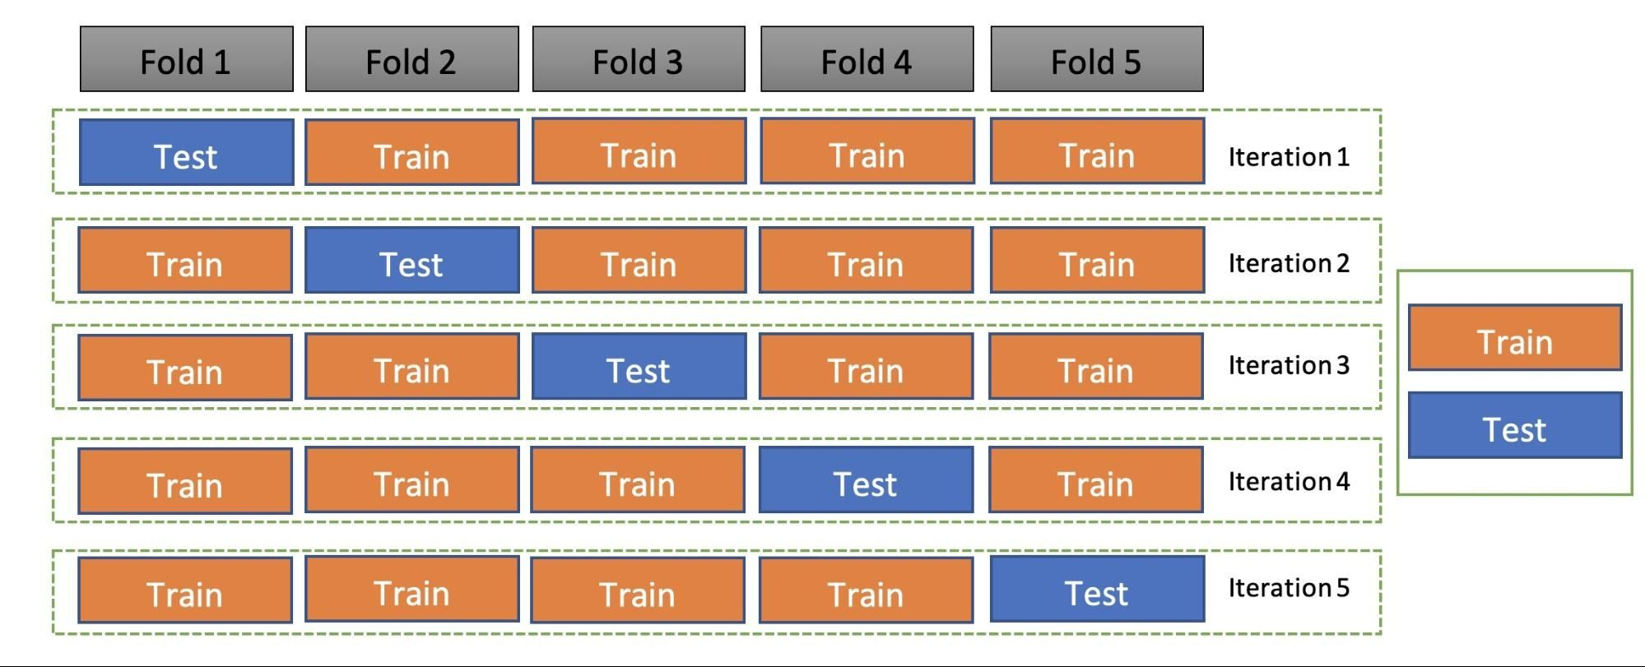
In each iteration, one fold is the test set/validation set and the other k-1 sets (4 sets) are the train set. To get the final accuracy, you need to take the accuracy of the k-models validation data.

Slide 30
Limitations of Cross-Validation
1.For the ideal conditions, it provides the optimum output. But for the inconsistent data, it may produce a drastic result.
2. In predictive modeling, the data evolves over a period, due to which, it may face the differences between the training set and validation sets.
.

Slide 31
Applications of Cross-Validation
This technique can be used to compare the performance of different predictive modeling methods.
It has great scope in the medical research field.
It can also be used for the meta-analysis, as it is already being used by the data scientists in the field of medical statistics.

